Slide 1

Object-Oriented Database Management Systems
The goal of all inanimate objects is to resist man and ultimately to defeat him
Russell Baker, 1968

Slide 2
Shortcomings of relational model
It cannot handle complex objects such as multimedia
There is no support for general data types
Performance degrades when large numbers of tables must be joined
There is a mismatch between the relational data model’s set-at-a-time processing and the record-at-a-time processing of programming languages
There is no support for representing and recording change, such as different versions of objects

Slide 3
UML
Unified modeling language
Introduced in 1997
Common modeling language for OO software development

Slide 4
OO and IS management
The goal of IS management is to deliver projects:
  On time
  On budget
  Fully functional
OO technology offers an opportunity to meet these goals

Slide 5
Why OO and ODBMS?
Procedural languages and relational databases are not designed to handle complex data such as
  Multimedia
  CAD/CAM
  Economic models
  Document management systems
  Complex data structures

Slide 6
Historical development
The first OOPL was developed in Norway in the mid 60s
Smalltalk appeared in the 70s
Java and COBOL support OO concepts
OOPLs are well suited for GUI applications

Slide 7
Data and OO modeling
Data Modeling Term | OO Modeling Term
Entity | Object class or classes
Instance | Object
Attribute | Attribute

Slide 8
Key concepts
Data abstraction
Object instances and classes
Encapsulation
Message passing
Generalization/specialization hierarchies
Inheritance
Reuse

Slide 9
Data Abstraction
Abstract model of reality
Essential elements of relationships

Slide 10
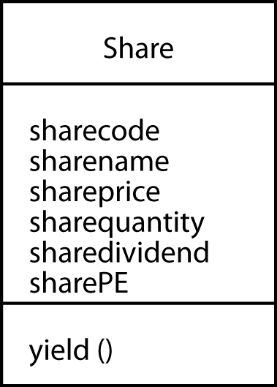
Object instances and classes
Object instance
  Single representations
Object classes
  A collection of objects of the same type
  e.g., SHARE
  Similar concept to an entity
Object identification (OID)
  Unique reference to an object instance

Slide 11
Encapsulation
A central concept
All the processing is done within the object
An object is shielded from interference by other objects

Slide 12
Message passing
Objects communicate by sending and receiving messages
The receiving object needs a method for handling the message
A message can trigger a change in a receiving object

Slide 13
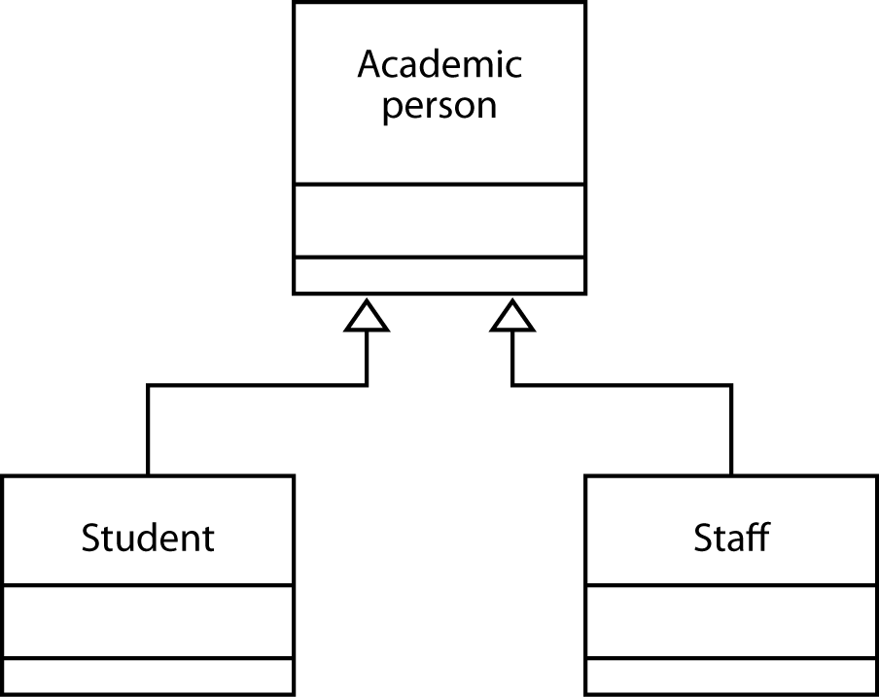
Generalization/specialization hierarchies
Classes can be generalizations or specializations of other classes
ACADEMIC PERSON is a generalization of subclasses student and staff
STUDENT is a specialization of superclass ACADEMIC PERSON

Slide 14
Inheritance
A subclass can inherit the data and methods of its superclass
Simplifies programming
Creates reusable objects

Slide 15
Reuse
Reusable code has been a persistent goal of IS managers
Objects are building blocks for assembling new applications
A major means of increasing programmer productivity

Slide 16
Why OO?
Reducing the application backlog
Overcoming the slow growth in programmer productivity
Reducing maintenance problems

Slide 17
Reducing maintenance
Objects are relatively independent so there is less ripple effect
OO concepts are closer to the way clients think so there are less specification errors
Prototyping is easy
Objects are easily modified

Slide 18
OO Concepts

Slide 19
Objects and IS modeling
A model is an abstraction of the real world
  e.g., a map
A model should reduce the communication gap between the client and analyst
  Match the way the client thinks
  Help capture client’s needs

Slide 20
Types of models
Data and procedures
Static and dynamic
  Static
    What the system can do
  Dynamic
    What the system does

Slide 21
Finding objects and classes
Observe and listen
Look for structures

Slide 22
Layers of an OO model
Class and object layer
Structure layer
Attribute layer
Service layer

Slide 23
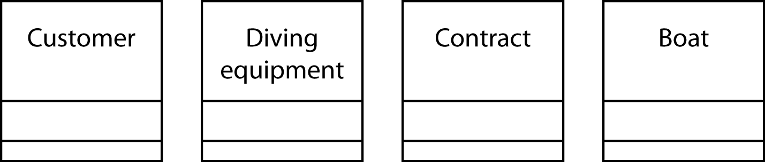
Object layer
Identifying objects and classes
Underline the nouns in the problem description
  Customers can rent diving equipment and boats from DDT. When a customer has seen what is available and decided what to rent, a rental agreement or contract is produced and signed

Slide 24
Structure layer
Generalization/specialization
Whole/part

Slide 25
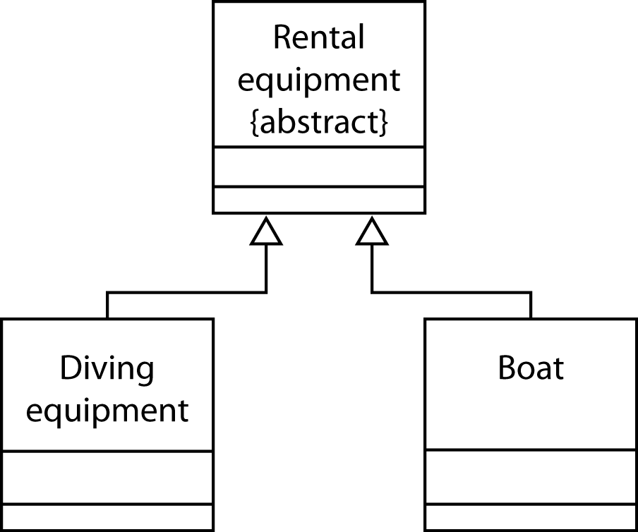
Generalization/specialization
The attributes and methods established for RENTAL EQUIPMENT are inherited by the classes DIVING EQUIPMENT and BOAT

Slide 26
Abstract classes
Only diving equipment and boats are rented
  RENTAL EQUIPMENT does not contain objects
RENTAL EQUIPMENT is an abstract class

Slide 27
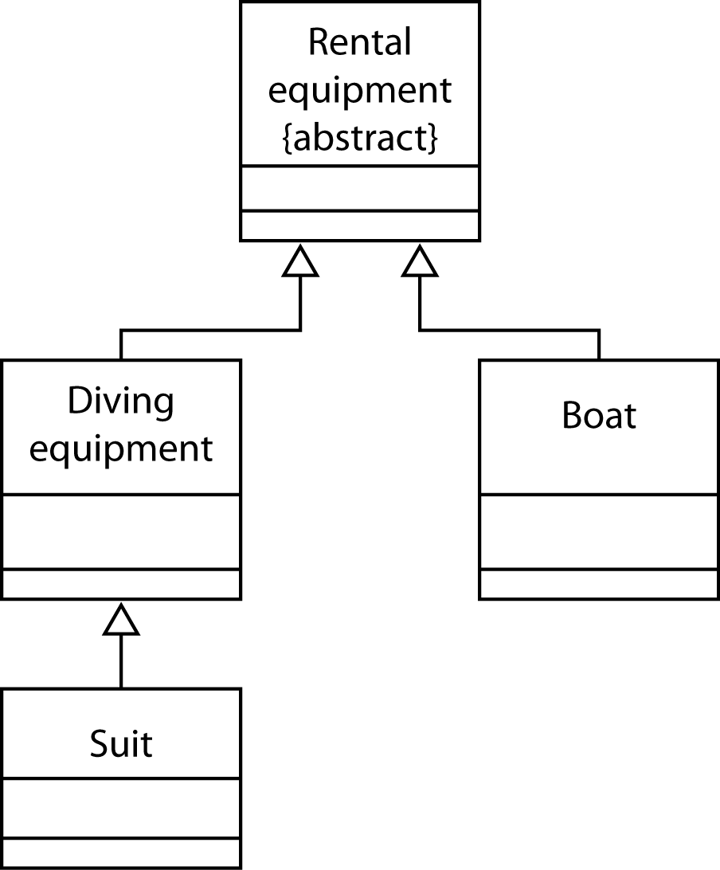
Generalization/specialization
SUIT is a ‘kind of’ DIVING EQUIPMENT
SUIT inherits the attributes and methods of DIVING EQUIPMENT

Slide 28
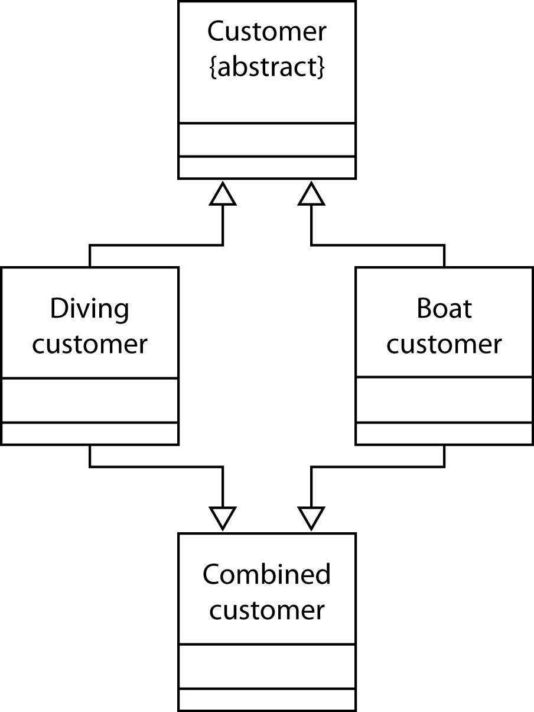

Multiple inheritance
A class can inherit attributes and methods from multiple superclasses
Not supported by all OOPLs because of possible conflicts

Slide 29
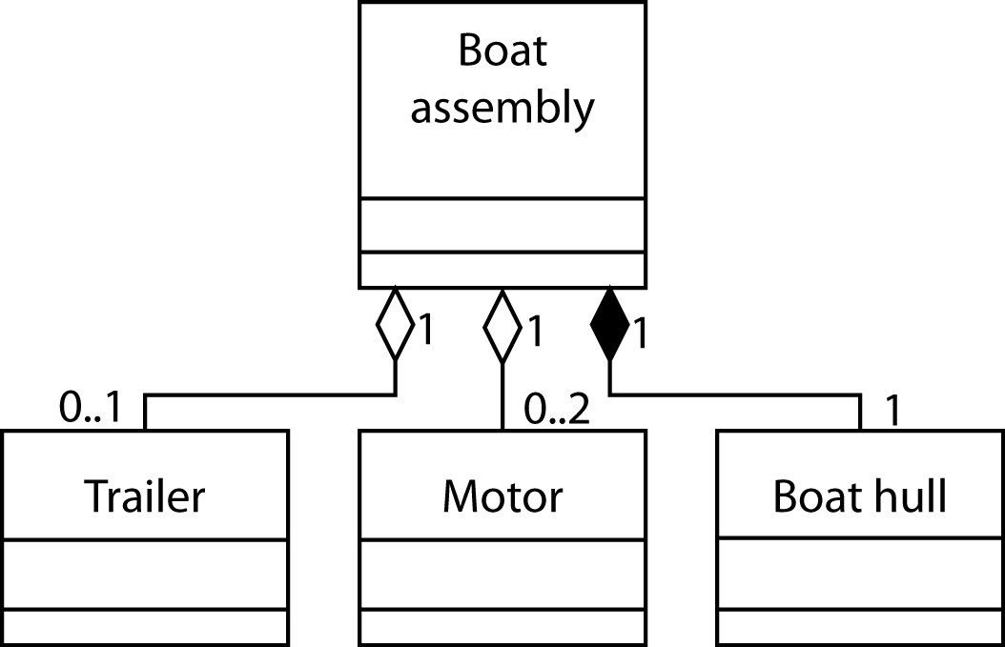
Whole/part structures
A composition or aggregation
TRAILER ‘is part of’ BOAT ASSEMBLY
Distinguished by the diamond

Slide 30
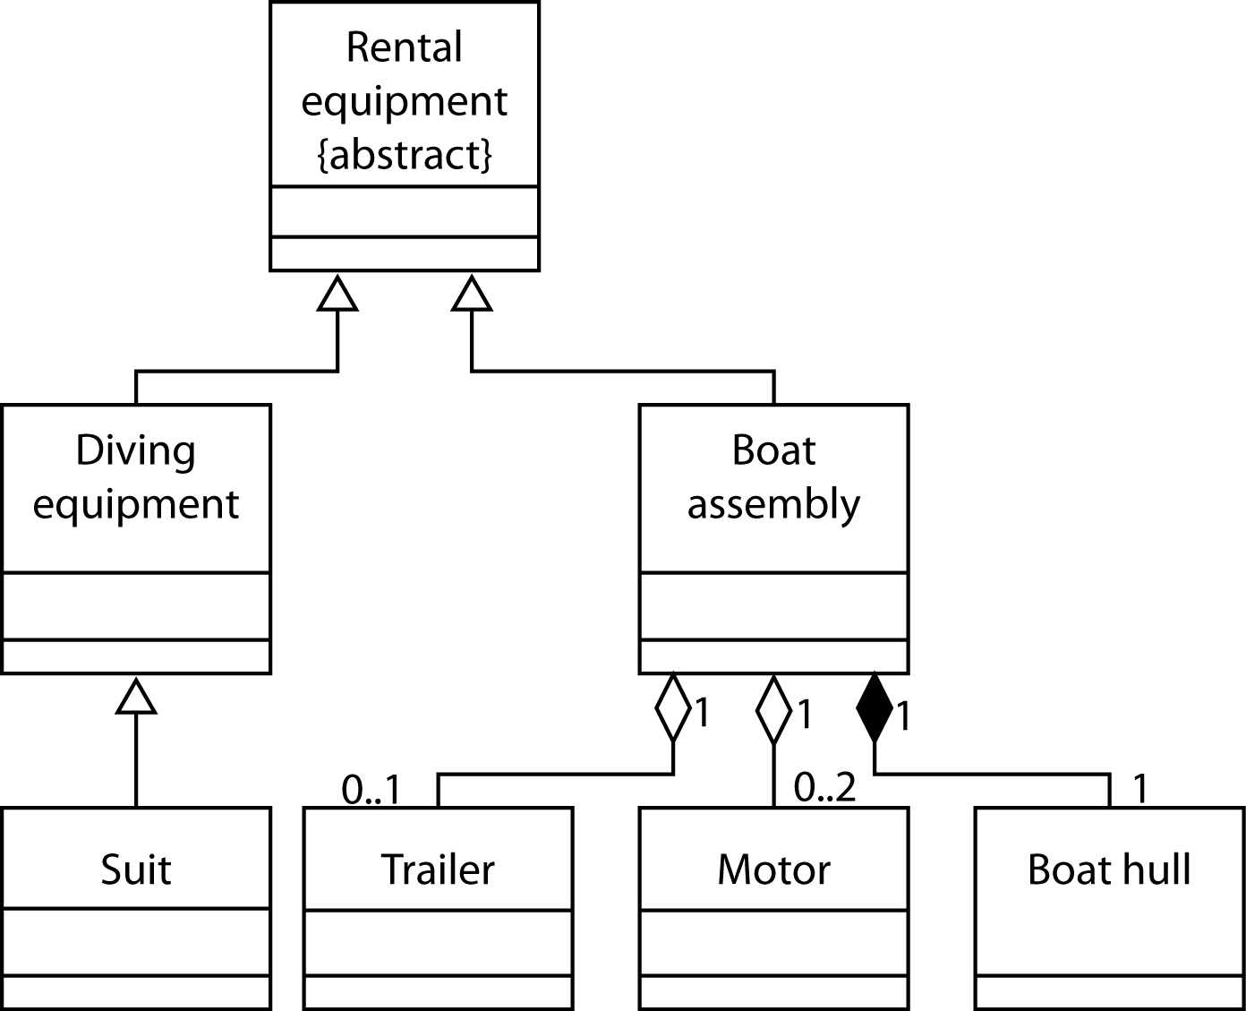
Object model – take 1

Slide 31
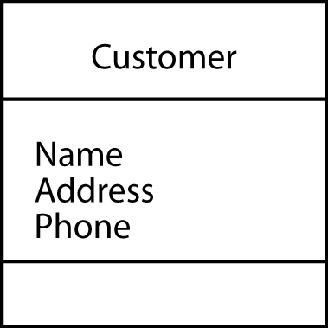
Attribute layer
Specification of attributes
Specification of association relationships
Specification is similar to data modeling

Slide 32
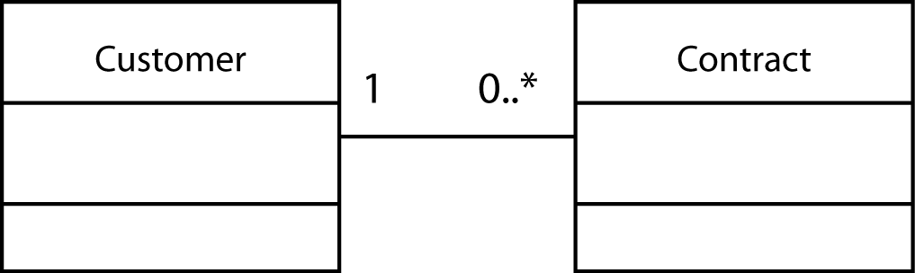
Association relationships
Depict links between actual object occurrences

Slide 33
Association relationships
Can also depict an aggregation relationship
  A special version of an association relationship
  Items in a contract are part of a contract

Slide 34
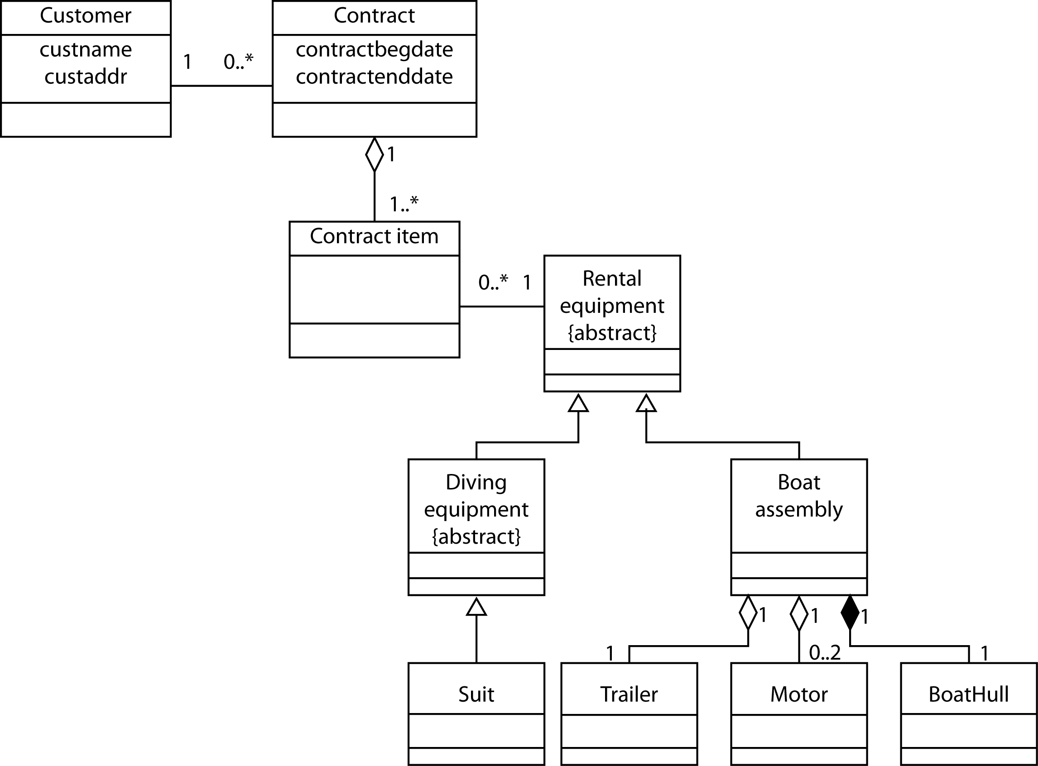
Object model - final version

Slide 35
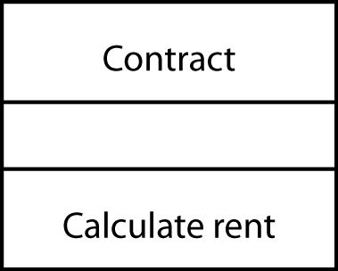
Service layer
Describes processing for each specified object
Simple services
  Standard services all objects are expected to perform
  Implicit and not shown
Complex
  Non-standard services
  Shown explicitly

Slide 36
OO and relational paradigms
OO paradigm | Relational paradigm
Based on software engineering principles of coupling, cohesion, and encapsulation | Founded on the mathematical concepts of set theory
The goal is to improve the quality of systems, and there is concern for both data and processes | The goal is to improve data management
To access data you traverse objects via relationships | To access data you match primary and foreign keys
Coupling is a measure of how cleanly the modules in a system are separated from one another.
Cohesion is the measure of the strength of functional relatedness of elements within a module.

Slide 37
Mapping
Each attribute is mapped to zero or more columns
  Non-persistent (i.e., derived) attributes are not mapped
  Some attributes need to be broken into components

Slide 38
Mapping
Generalization
  Vertical
    Each class is mapped to a separate table
    Recommended
  Horizontal
    Each subclass is mapped to a different table
    The superclass is not mapped to a table
  Filtered
    All classes are mapped to the same table
    The table contains columns for all attributes in both classes with a column added to distinguish between the subclasses.

Slide 39
Mapping
Association and aggregation
  Associations are mapped like their corresponding data model parallels
    e.g., an m:m association is mapped by creating an associative entity
  Physically, an aggregation might be implemented using clustering or a linked list because the whole and parts are often retrieved together

Slide 40
The role of the ODBMS
Objects have a life that extends beyond the execution of the OO program
Persistent objects live longer than the methods that create them
An ODBMS stores data when the OO application is not running

Slide 41
Types of persistence
Short lived
  Exists only during the life of the method
Long lived
  Objects remain stored until the database is deleted
  The purpose of an ODBMS is to store long lived objects

Slide 42
Features of an ODBMS
An ODBMS supports OO concepts
  complex objects
  abstract data types
  encapsulation
  inheritance
An ODBMS also provides
  data sharing
  concurrent data access
  recovery control

Slide 43
Overcoming the impedance problem
There is a difference between set-at-a-time processing of a RDBMS and record-at-a-time processing of procedural programming languages
Some procedural languages do not handle RDBMS data types and arithmetic (e.g., dates)
OO programming languages and ODBMSs fit together more closely than RDBMSs and procedural languages
  All operations are at the record level

Slide 44
The Object Database Standard
The OMG (Object Management Group) is creating and promulgating a standard for OO technology
The goal is to minimize incompatibility across platforms and standardize some features
OMG has released an Object Database Standard

Slide 45
ODBMS versus RDBMS
Support for storage and manipulation of complex objects
Raised the level of abstraction by introducing classes and inheritance
Overcomes the impedance mismatch
Set level processing with SQL makes ad hoc querying easier than record-at-a-time processing

Slide 46
Directions
Pure object database
Hybrid object-relational
  Favored path
Interest in OO appears to have peaked

Slide 47
Hybrid Technology
Object-relational databases
Extended-relational systems
Universal servers
User-defined datatypes
  Distinct datatypes
    Simple datatypes that extend the basic datatypes
  Abstract datatypes
    Complex datatypes with internal structures and attributes
      geospatial or time-series data

Slide 48
The future
RDBMS
  Non-complex object stores
  Incorporate OO concepts without compromising the relational model
ODBMS
  Complex object stores
  Incorporate relational concepts without losing advantages of OO concepts
A hybrid object-relational model

